Slide 1
CS162 Operating Systems and Systems Programming Lecture 11 Scheduling (finished), Deadlock, Address Translation
October 3rd, 2018
Nathan Pemberton
http://cs162.eecs.Berkeley.edu

Slide 2
Recap: What if we Knew the Future?
Could we always mirror best FCFS?
Shortest Job First (SJF):
Run whatever job has least amount of computation to do
Sometimes called “Shortest Time to Completion First” (STCF)
Shortest Remaining Time First (SRTF):
Preemptive version of SJF: if job arrives and has a shorter time to completion than the remaining time on the current job, immediately preempt CPU
Sometimes called “Shortest Remaining Time to Completion First” (SRTCF)
These can be applied to whole program or current CPU burst
Idea is to get short jobs out of the system
Big effect on short jobs, only small effect on long ones
Result is better average response time
Notes:
Rich get richer, and poor get poorer = short jobs get through the system faster, long jobs take even longer

Slide 3
Recap: Discussion
SJF/SRTF are the best you can do at minimizing average response time
Provably optimal (SJF among non-preemptive, SRTF among preemptive)
Since SRTF is always at least as good as SJF, focus on SRTF
Comparison of SRTF with FCFS and RR
What if all jobs the same length?
SRTF becomes the same as FCFS (i.e. FCFS is best can do if all jobs the same length)
What if jobs have varying length?
SRTF (and RR): short jobs not stuck behind long ones

Slide 4
Example to illustrate benefits of SRTF
A or B
C
C’s
I/O
C’s
I/O
C’s
I/O
Three jobs:
A, B: both CPU bound, run for week C: I/O bound, loop 1ms CPU, 9ms disk I/O
If only one at a time, C uses 90% of the disk, A or B could use 100% of the CPU
With FIFO:
Once A or B get in, keep CPU for two weeks
What about RR or SRTF?
Easier to see with a timeline

Slide 5
SRTF Example continued:
Disk Utilization:
9/201 ~ 4.5%
C
A
B
C
RR 100ms time slice
Disk Utilization:
~90% but lots of wakeups!
C’s
I/O
C’s
I/O
CABAB…
C
RR 1ms time slice
C’s
I/O
C’s
I/O
Disk Utilization:
90%
C
A
A
A
SRTF
C’s
I/O
C’s
I/O

Slide 6
SRTF Further discussion
Starvation
SRTF can lead to starvation if many small jobs!
Large jobs never get to run
Somehow need to predict future
How can we do this?
Some systems ask the user
When you submit a job, have to say how long it will take
To stop cheating, system kills job if takes too long
But: hard to predict job’s runtime even for non-malicious users
Notes:
Add graph showing how good people are at predicting

Slide 7
Users can’t predict runtime (even if they’re paid to!)
Asked for 36 hours,
Ran for 1 minute!

Slide 8
SRTF Further discussion (Cont.)
Bottom line, can’t really know how long job will take
However, can use SRTF as a yardstick for measuring other policies
Optimal, so can’t do any better
SRTF Pros & Cons
Optimal (average response time) (+)
Hard to predict future (-)
Unfair (-)
Notes:
Ask Question: Pros/Cons of SRTF

Slide 9
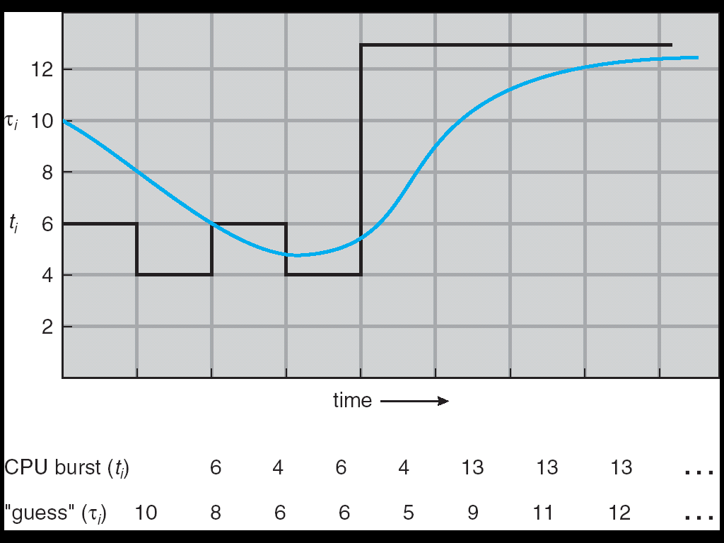
Predicting the Length of the Next CPU Burst
Adaptive: Changing policy based on past behavior
CPU scheduling, in virtual memory, in file systems, etc
Works because programs have predictable behavior
If program was I/O bound in past, likely in future
If computer behavior were random, wouldn’t help
Example: SRTF with estimated burst length
Use an estimator function on previous bursts: Let t_{n-1}, t_{n-2}, t_{n-3}, etc. be previous CPU burst lengths. Estimate next burst τ_{n} = f(t_{n-1}, t_{n-2}, t_{n-3}, …)
Function f could be one of many different time series estimation schemes (Kalman filters, etc)
For instance, exponential averaging τ_{n} = αt_{n-1}+(1-α)τ_{n-1} with (0<α≤1)

Slide 10
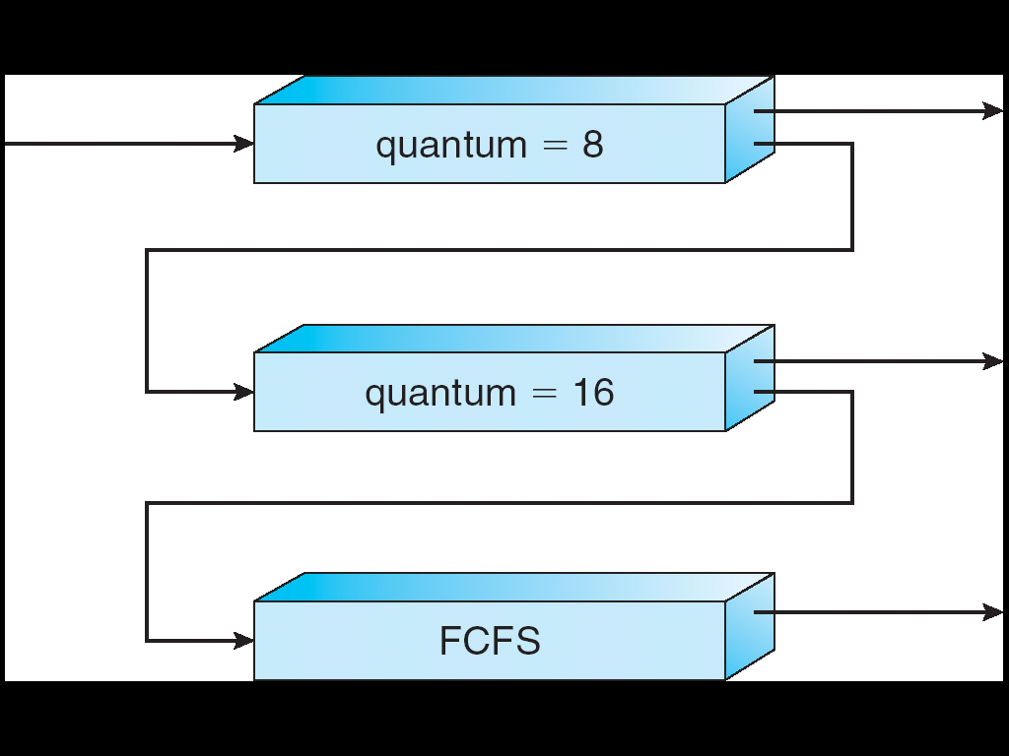
Multi-Level Feedback Scheduling
Another method for exploiting past behavior (first use in CTSS)
Multiple queues, each with different priority
Higher priority queues often considered “foreground” tasks
Each queue has its own scheduling algorithm
e.g. foreground – RR, background – FCFS
Sometimes multiple RR priorities with quantum increasing exponentially (highest:1ms, next: 2ms, next: 4ms, etc)
Adjust each job’s priority as follows (details vary)
Job starts in highest priority queue
If timeout expires, drop one level
If timeout doesn’t expire, push up one level (or to top)
Long-Running Compute Tasks Demoted to Low Priority

Slide 11
Scheduling Details
Long-Running Compute Tasks Demoted to Low Priority
Result approximates SRTF:
CPU bound jobs drop like a rock
Short-running I/O bound jobs stay near top
Scheduling must be done between the queues
Fixed priority scheduling:
serve all from highest priority, then next priority, etc.
Time slice:
each queue gets a certain amount of CPU time
e.g., 70% to highest, 20% next, 10% lowest

Slide 12
Scheduling Details
Long-Running Compute Tasks Demoted to Low Priority
Countermeasure: user action that can foil intent of OS designers
For multilevel feedback, put in a bunch of meaningless I/O to keep job’s priority high
Of course, if everyone did this, wouldn’t work!
Example of Othello program:
Playing against competitor, so key was to do computing at higher priority the competitors.
Put in printf’s, ran much faster!
Notes:
* Give example of tail-latency and how MLFQ interacts badly with it.
* What is Othello Program?

Slide 13
Real-Time Scheduling (RTS)
Efficiency is important but predictability is essential:
We need to predict with confidence worst case response times for systems
In RTS, performance guarantees are:
Task- and/or class centric and often ensured a priori
In conventional systems, performance is:
System/throughput oriented with post-processing (… wait and see …)
Real-time is about enforcing predictability, and does not equal fast computing!!!
Hard Real-Time
Attempt to meet all deadlines
EDF (Earliest Deadline First), LLF (Least Laxity First), RMS (Rate-Monotonic Scheduling), DM (Deadline Monotonic Scheduling)
Soft Real-Time
Attempt to meet deadlines with high probability
Minimize miss ratio / maximize completion ratio (firm real-time)
Important for multimedia applications
CBS (Constant Bandwidth Server)

Slide 14
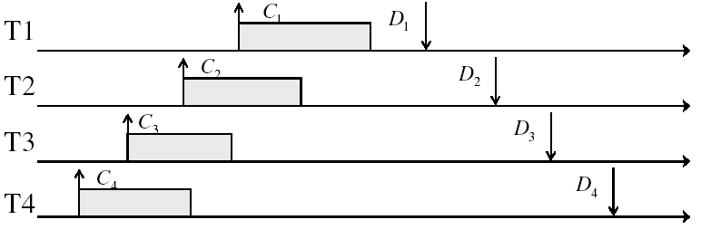
Example: Workload Characteristics
Tasks are preemptable, independent with arbitrary arrival (=release) times
Tasks have deadlines (D) and known computation times (C)
Example Setup:

Slide 15
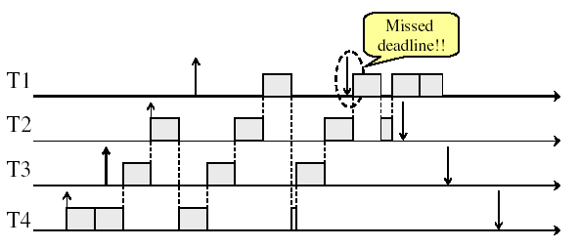
Example: Round-Robin Scheduling Doesn’t Work
Time

Slide 16
Earliest Deadline First (EDF)
Tasks periodic with period P and computation C in each period: (P, C)
Preemptive priority-based dynamic scheduling
Each task is assigned a (current) priority based on how close the absolute deadline is
The scheduler always schedules the active task with the closest absolute deadline
0
5
10
15

Slide 17
A Final Word On Scheduling
When do the details of the scheduling policy and fairness really matter?
When there aren’t enough resources to go around
When should you simply buy a faster computer?
(Or network link, or expanded highway, or …)
One approach: Buy it when it will pay for itself in improved response time
Assuming you’re paying for worse response time in reduced productivity, customer angst, etc…
Might think that you should buy a faster X when X is utilized 100%, but usually, response time goes to infinity as utilization⇒100%
An interesting implication of this curve:
Most scheduling algorithms work fine in the “linear” portion of the load curve, fail otherwise
Argues for buying a faster X when hit “knee” of curve
Response
time
100%
Utilization

Slide 18
Deadlock

Slide 19
Starvation vs Deadlock
Starvation vs. Deadlock
Starvation: thread waits indefinitely
Example, low-priority thread waiting for resources constantly in use by high-priority threads
Deadlock: circular waiting for resources
Thread A owns Res 1 and is waiting for Res 2 Thread B owns Res 2 and is waiting for Res 1
Deadlock ⇒ Starvation but not vice versa
Starvation can end (but doesn’t have to)
Deadlock can’t end without external intervention
Thread
A
Wait
For
Owned
By
Res 1
Res 2
Owned
By
Wait
For
Thread
B

Slide 20
Bridge Crossing Example
Honk!
Each segment of road can be viewed as a resource
Car must own the segment under them
Must acquire segment that they are moving into
For bridge: must acquire both halves
Traffic only in one direction at a time
Problem occurs when two cars in opposite directions on bridge: each acquires one segment and needs next
If a deadlock occurs, it can be resolved if one car backs up (preempt resources and rollback)
Several cars may have to be backed up
Starvation is possible
East-going traffic really fast ⇒ no one goes west

Slide 21
Conditions for Deadlock
Deadlock not always deterministic – Example 2 mutexes:
Thread A Thread B
x.P(); y.P();
y.P(); x.P();
y.V(); x.V();
x.V(); y.V();
Deadlock won’t always happen with this code
Have to have exactly the right timing (“wrong” timing?)
So you release a piece of software, and you tested it, and there it is, controlling a nuclear power plant…
Deadlocks occur with multiple resources
Means you can’t decompose the problem
Can’t solve deadlock for each resource independently
Example: System with 2 disk drives and two threads
Each thread needs 2 disk drives to function
Each thread gets one disk and waits for another one

Slide 22
Four requirements for Deadlock
Mutual exclusion
Only one thread at a time can use a resource.
Hold and wait
Thread holding at least one resource is waiting to acquire additional resources held by other threads
No preemption
Resources are released only voluntarily by the thread holding the resource, after thread is finished with it
Circular wait
There exists a set {T₁, …, T_{n}} of waiting threads
T₁ is waiting for a resource that is held by T₂
T₂ is waiting for a resource that is held by T₃
…
T_{n} is waiting for a resource that is held by T₁

Slide 23
Resource-Allocation Graph
Symbols
System Model
A set of Threads T₁, T₂, . . ., T_{n}
Resource types R₁, R₂, . . ., R_{m}
CPU cycles, memory space, I/O devices
Each resource type R_{i} has W_{i} instances
Each thread utilizes a resource as follows:
Request() / Use() / Release()
Resource-Allocation Graph:
V is partitioned into two types:
T = {T₁, T₂, …, T_{n}}, the set threads in the system.
R = {R₁, R₂, …, R_{m}}, the set of resource types in system
request edge – directed edge T₁ → R_{j}
assignment edge – directed edge R_{j} → T_{i}
T₁
T₂
R₁
R₂

Slide 24
Resource Allocation Graph Examples
Recall:
request edge – directed edge T₁ → R_{j}
assignment edge – directed edge R_{j} → T_{i}
R₁
R₂
R₁
R₂
R₁
T₂
T₁
T₂
T₃
T₁
T₂
T₃
T₁
T₃
R₃
T₄
R₄
R₃
R₂
R₄
Simple Resource
Allocation Graph
Allocation Graph With Deadlock
Allocation Graph With Cycle, but
No Deadlock

Slide 25
Administrivia
Midterm #1
regrade requests are due on 10/9 at 11:59pm
Upcoming Deadlines:
Project 1 Code due 10/5 (this Friday)
Project 1 Final Report due 10/8 (next Monday)
HW2 due 10/8 (next Monday)

Slide 26
Four requirements for Deadlock
Mutual exclusion
Only one thread at a time can use a resource.
Hold and wait
Thread holding at least one resource is waiting to acquire additional resources held by other threads
No preemption
Resources are released only voluntarily by the thread holding the resource, after thread is finished with it
Circular wait
There exists a set {T₁, …, T_{n}} of waiting threads
T₁ is waiting for a resource that is held by T₂
T₂ is waiting for a resource that is held by T₃
…
T_{n} is waiting for a resource that is held by T₁

Slide 27
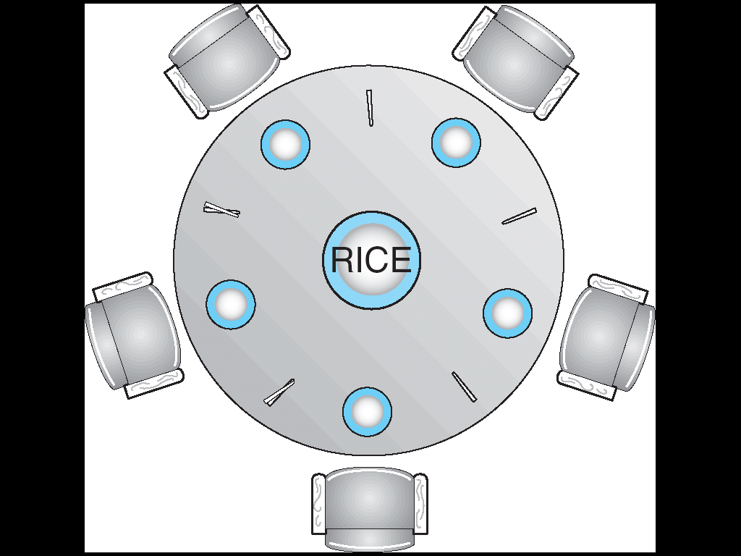
Dining Philosophers Problem
Five chopsticks/Five philosophers
Free-for all: Philosopher will grab any one they can
Need two chopsticks to eat
What if all grab at same time?
Deadlock!
How to fix deadlock?
Make one of them give up a chopstick (Hah!)
Eventually everyone will get chance to eat
How to prevent deadlock?
Never let philosopher take last chopstick if no hungry philosopher has two chopsticks afterwards
Notes:
* Change to dining philosopher: too canonical of an example to not continue the tradition
** Find out history of dining philosophers (dijkstra?)

Slide 28
Review: Train Example (Wormhole-Routed Network)
Circular dependency (Deadlock!)
Each train wants to turn right
Blocked by other trains
Similar problem to multiprocessor networks
Fix? Imagine grid extends in all four directions
Force ordering of channels (tracks)
Protocol: Always go east-west first, then north-south
Called “dimension ordering” (X then Y)
Disallowed
By Rule

Slide 29
Methods for Handling Deadlocks
Allow system to enter deadlock and then recover
Requires deadlock detection algorithm
Some technique for forcibly preempting resources and/or terminating tasks
Ensure that system will never enter a deadlock
Need to monitor all lock acquisitions
Selectively deny those that might lead to deadlock
Ignore the problem and pretend that deadlocks never occur in the system
Used by most operating systems, including UNIX
Notes:
* Set up last point, it's a surprisingly common solution

Slide 30
Deadlock Detection Algorithm
Only one of each type of resource ⇒ look for loops
More General Deadlock Detection Algorithm
Let [X] represent an m-ary vector of non-negative integers (quantities of resources of each type):
[FreeResources]: Current free resources each type [Request_{X}]: Current requests from thread X [Alloc_{X}]: Current resources held by thread X
See if tasks can eventually terminate on their own
[Avail] = [FreeResources] Add all nodes to UNFINISHED do {
done = true Foreach node in UNFINISHED { if ([Request_{node}] <= [Avail]) { remove node from UNFINISHED [Avail] = [Avail] + [Alloc_{node}] done = false } } } until(done)
Nodes left in UNFINISHED ⇒ deadlocked
R₁
T₂
T₁
T₃
T₄
R₂

Slide 31
What to do when detect deadlock?
Terminate thread, force it to give up resources
In Bridge example, Godzilla picks up a car, hurls it into the river. Deadlock solved!
Shoot a Zax
But, not always possible – killing a thread holding a mutex leaves world inconsistent
Preempt resources without killing off thread
Take away resources from thread temporarily
Doesn’t always fit with semantics of computation
Roll back actions of deadlocked threads
Hit the rewind button, pretend last few minutes never happened
For bridge example, make one car roll backwards (may require others behind him)
Common technique in databases (transactions)
Of course, if you restart in exactly the same way, may reenter deadlock once again
Many operating systems use other options

Slide 32
Resource Requests over Time
Applications usually don’t know exactly when/what they’re going to request
Resources are taken/released over time
R₁
R₂
T₁
T₂
T₃
T₄
R₃

Slide 33
Techniques for Preventing Deadlock
Infinite resources
Include enough resources so that no one ever runs out of resources. Doesn’t have to be infinite, just large
Give illusion of infinite resources (e.g. virtual memory)
Examples:
Bay bridge with 12,000 lanes. Never wait!
Infinite disk space (not realistic yet?)
No Sharing of resources (totally independent threads)
Often true (most things don’t depend on each other)
Not very realistic in general (can’t guarantee)
Don’t allow waiting
How the phone company avoids deadlock
Call to your Mom in Toledo, works its way through the phone lines, but if blocked get busy signal.
Or straight to voicemail on cell phones
Technique used in Ethernet/some multiprocessor nets
Everyone speaks at once. On collision, back off and retry
Inefficient, since have to keep retrying
Consider: driving to San Francisco; when hit traffic jam, suddenly you’re transported back home and told to retry!

Slide 34
Techniques for Preventing Deadlock (cont’d)
Make all threads request everything they’ll need at the beginning.
Problem: Predicting future is hard, tend to over-estimate resources
Example:
If need 2 chopsticks, request both at same time
Don’t leave home until we know no one is using any intersection between here and where you want to go; only one car on the Bay Bridge at a time
Force all threads to request resources in a particular order preventing any cyclic use of resources
Thus, preventing deadlock
Example (x.P, y.P, z.P,…)
Make tasks request disk, then memory, then…
Keep from deadlock on freeways around SF by requiring everyone to go clockwise

Slide 35
Bankers Algorithm
What if you don’t know the order/amount of requests ahead of time?
Must assume some worst-case “max” resource needed by each process
Toward right idea:
State maximum resource needs in advance
Allow particular thread to proceed if:
(available resources - #requested) ≥ max remaining that might be needed by any thread
Invariant: At all times, every request would succeed
Really conservative!

Slide 36
Banker’s Algorithm for Preventing Deadlock
Invariant: At all times, there exists some order of requests that would succeed.
How to implement this?
Allocate resources dynamically
Evaluate each request and grant if some ordering of threads is still deadlock free afterward
Use deadlock detection algorithm presented earlier:
BUT: Assume each process needs ”max” resources to finish
[Avail] = [FreeResources] Add all nodes to UNFINISHED do {
done = true Foreach node in UNFINISHED { if ([Request_{node}] <= [Avail]) { remove node from UNFINISHED [Avail] = [Avail] + [Alloc_{node}] done = false } } } until(done)
[Avail] = [FreeResources] Add all nodes to UNFINISHED do {
done = true Foreach node in UNFINISHED { if ([Max_{node}]-[Alloc_{node}] <= [Avail]) { remove node from UNFINISHED [Avail] = [Avail] + [Alloc_{node}] done = false } } } until(done)
Each process might need“max” resources in order to finish

Slide 37
Banker’s Algorithm: Key Properties
Banker’s algorithm (less conservative):
Allocate resources dynamically
Evaluate each request and grant if some ordering of threads is still deadlock free afterward
Technique: pretend each request is granted, then run deadlock detection algorithm, substituting ([Max_{node}]-[Alloc_{node}] ≤ [Avail]) for ([Request_{node}] ≤ [Avail]) Grant request if result is deadlock free (conservative!)
Keeps system in a “SAFE” state, i.e. there exists a sequence {T₁, T₂, … T_{n}} with T₁ requesting all remaining resources, finishing, then T₂ requesting all remaining resources, etc..
Algorithm allows the sum of maximum resource needs of all current threads to be greater than total resources

Slide 38
Banker’s Algorithm Example
Banker’s algorithm with dining philosophers
“Safe” (won’t cause deadlock) if when try to grab chopstick either:
Not last chopstick
Is last chopstick but someone will have two afterwards
What if k-handed philosopher? Don’t allow if:
It’s the last one, no one would have k
It’s 2nd to last, and no one would have k-1
It’s 3rd to last, and no one would have k-2
…

Slide 39
Deadlock Prevention – The Reality
Deadlock Prevention is HARD
How many resources will each thread need?
How many total resources are there?
Also Slow/Impractical
Matrix of resources/requirements could be big and dynamic
Re-evaluate on every request (even for small/non-contended)
Banker’s algorithm assumes everyone asks for max
REALITY
Most OSs don’t bother
Programmers job to write deadlock-free programs (e.g. by ordering all resource requests).

Slide 40
Summary
Starvation (thread waits indefinitely) versus Deadlock (circular waiting for resources)
Four conditions for deadlocks
Mutual exclusion
Only one thread at a time can use a resource
Hold and wait
Thread holding at least one resource is waiting to acquire additional resources held by other threads
No preemption
Resources are released only voluntarily by the threads
Circular wait
∃ set {T₁, …, T_{n}} of threads with a cyclic waiting pattern
Techniques for addressing Deadlock
Allow system to enter deadlock and then recover
Ensure that system will never enter a deadlock
Ignore the problem and pretend that deadlocks never occur in system

